Slide 1
LEAVE REQUEST SYSTEM
Team 2 :
Septimanda Arianno
Yohana Agustina Br Ginting

Slide 2
AGENDA
Leave Request System
2. ERD
4. PL/SQL
3. ACTIVITY
DIAGRAM
1. USECASE
3. CLASS DIAGRAM

Slide 3
USECASE
Leave Request System

Slide 4
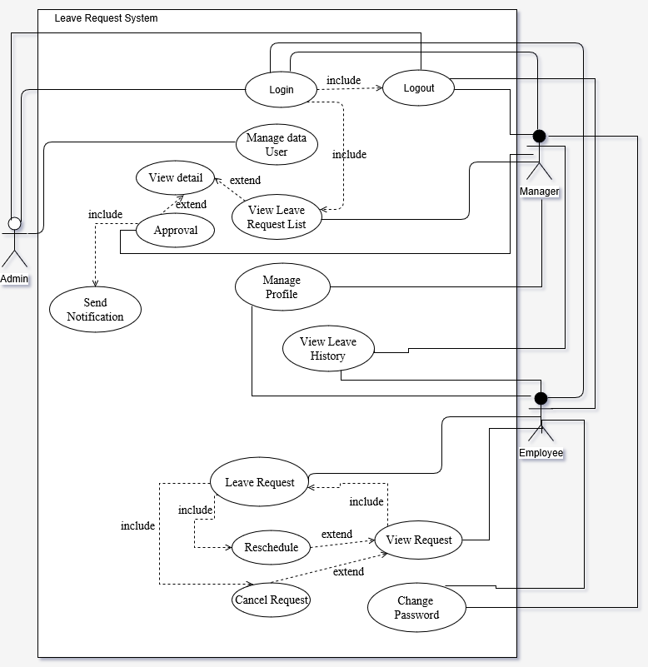

Slide 5
ENTITY RELATIONSHIP DIAGRAM
Leave Request System

Slide 6
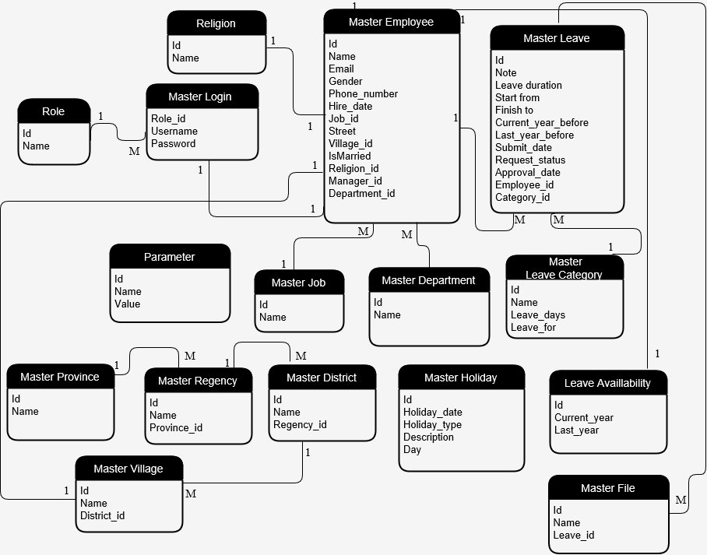

Slide 7
CLASS DIAGRAM
Leave Request System

Slide 8
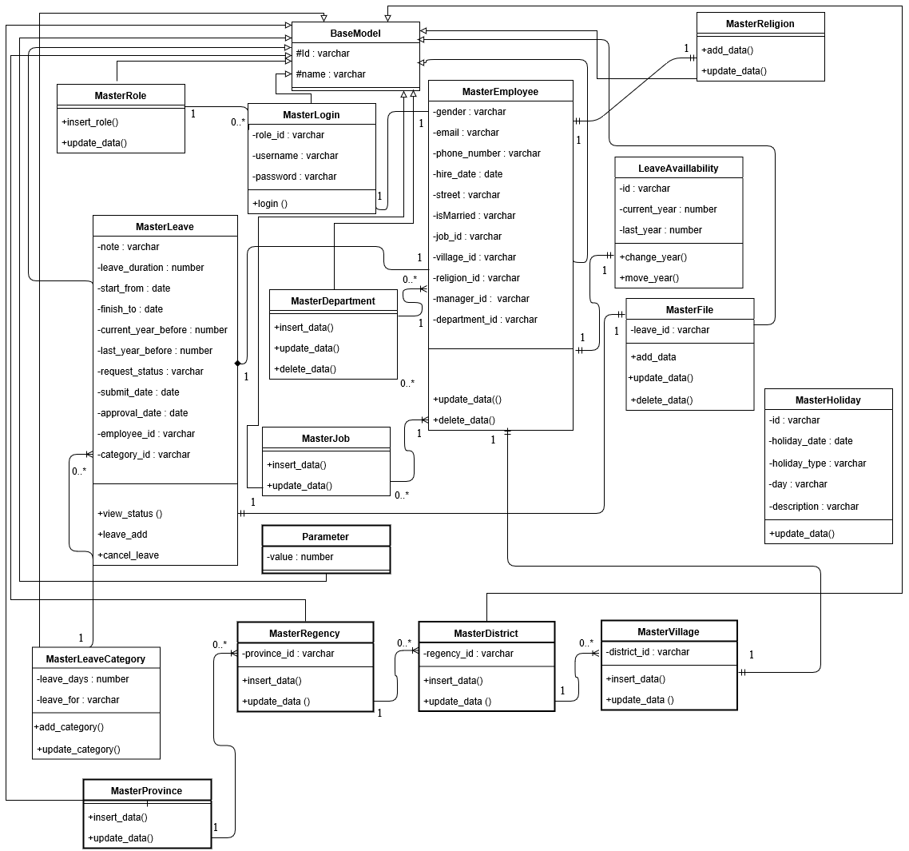

Slide 9
ACTIVITY DIAGRAM
Leave Request System

Slide 10
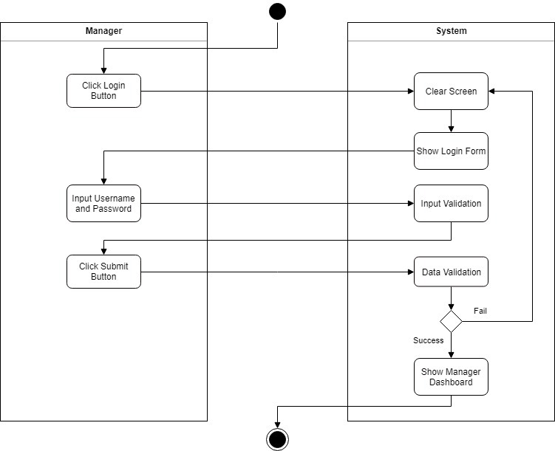
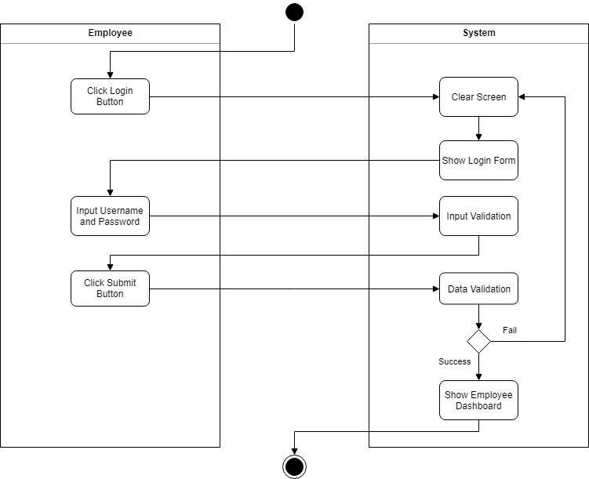
Login Employee
Login Manager

Slide 11
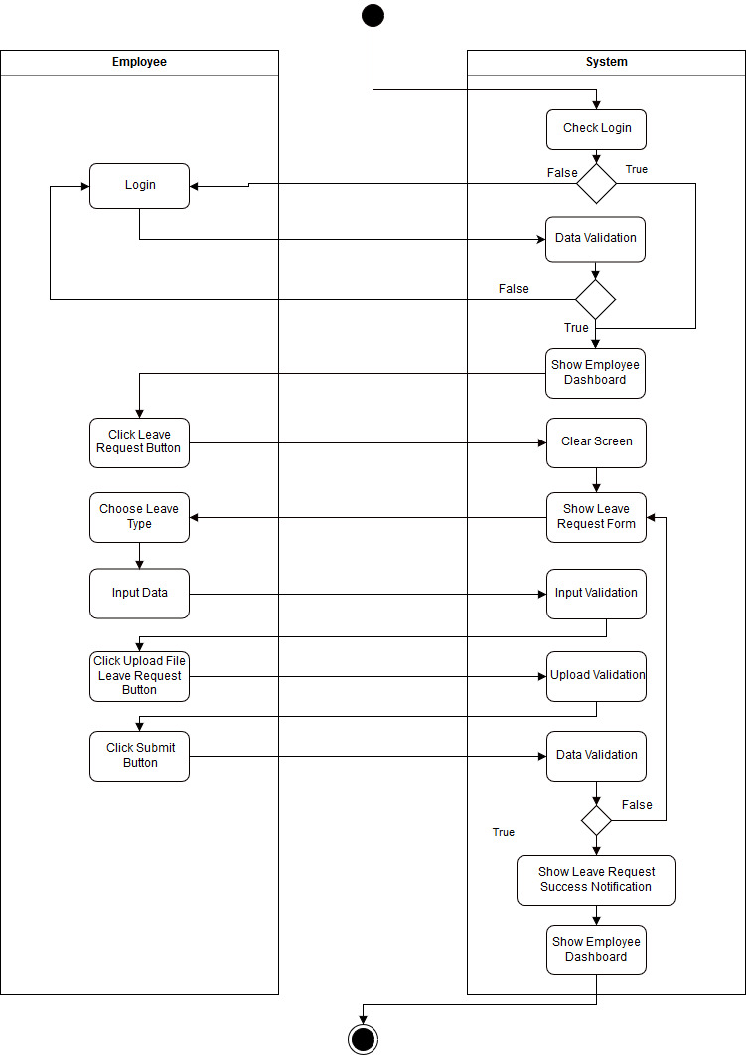
Leave Request

Slide 12
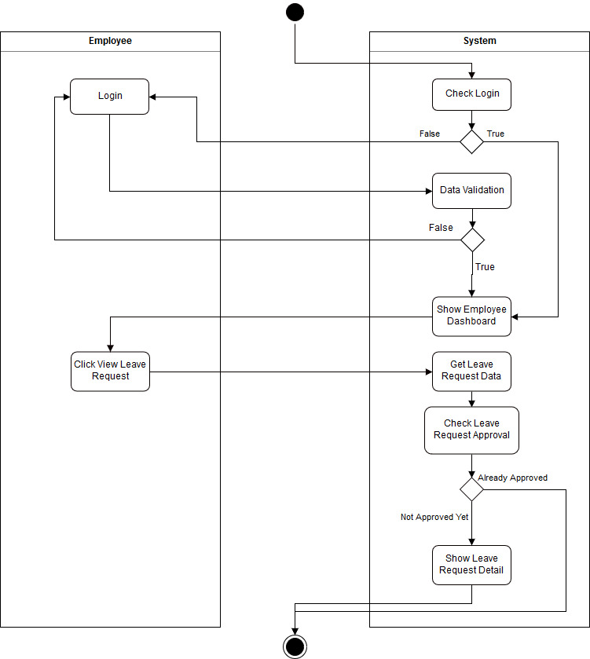
View
Leave Request

Slide 13
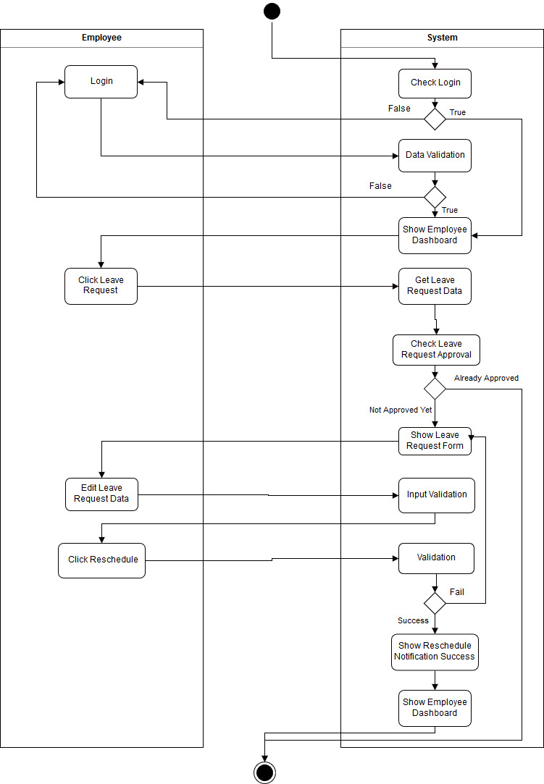
Reschedule
Leave Request

Slide 14
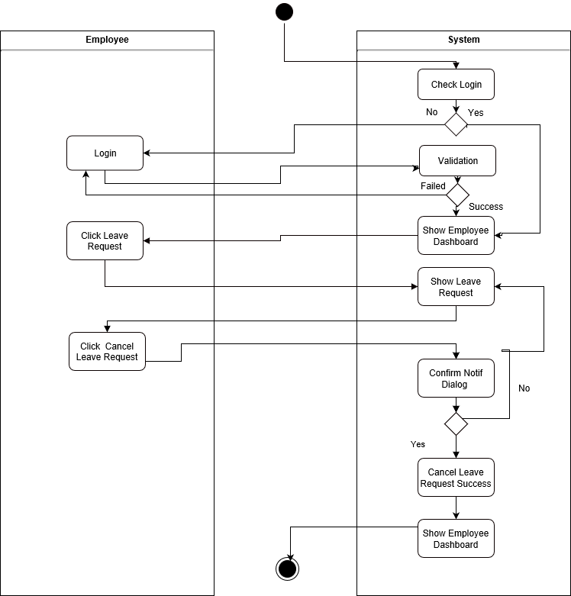
Cancel
Leave Request

Slide 15
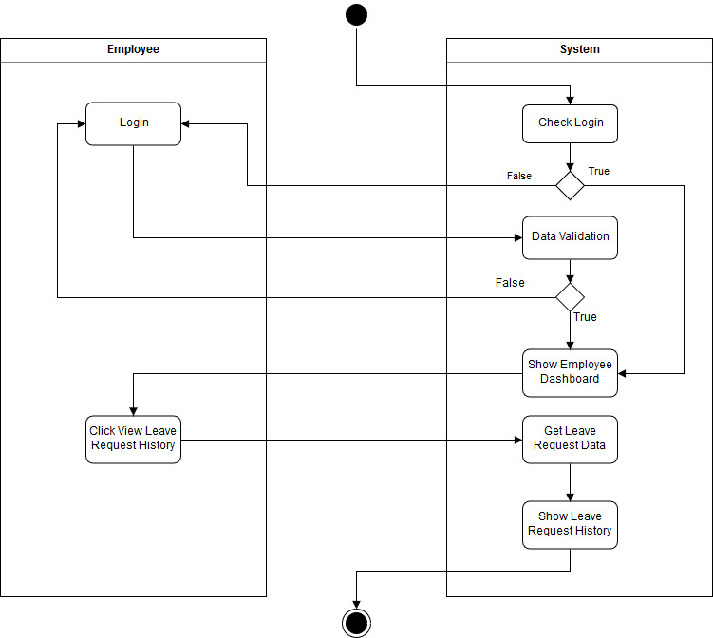
View
Leave History

Slide 16
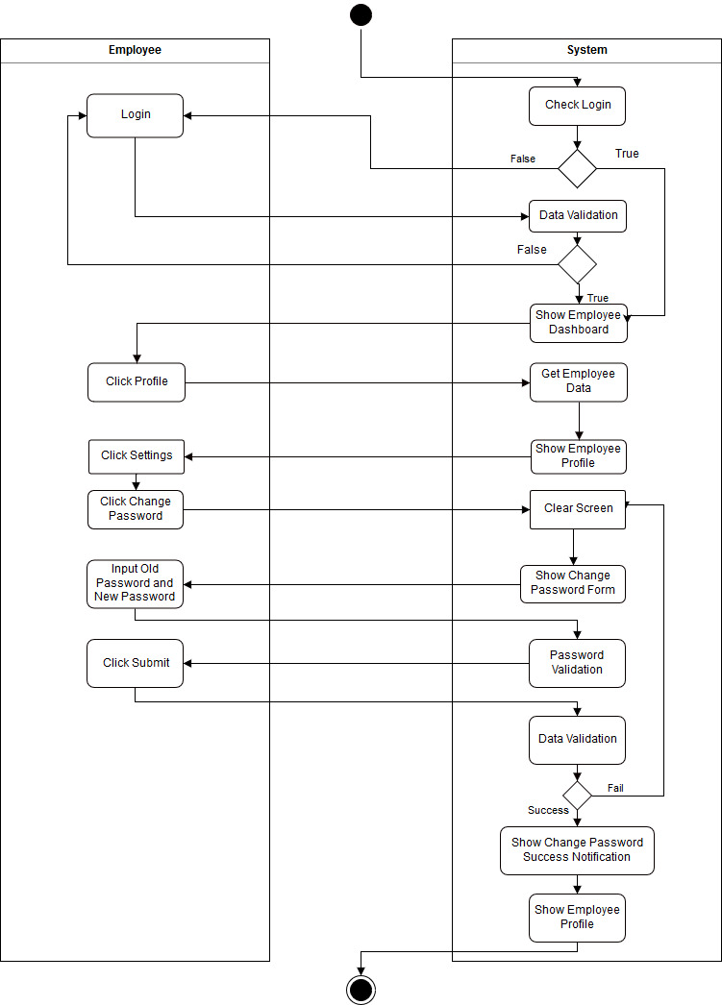
Change
Password

Slide 17
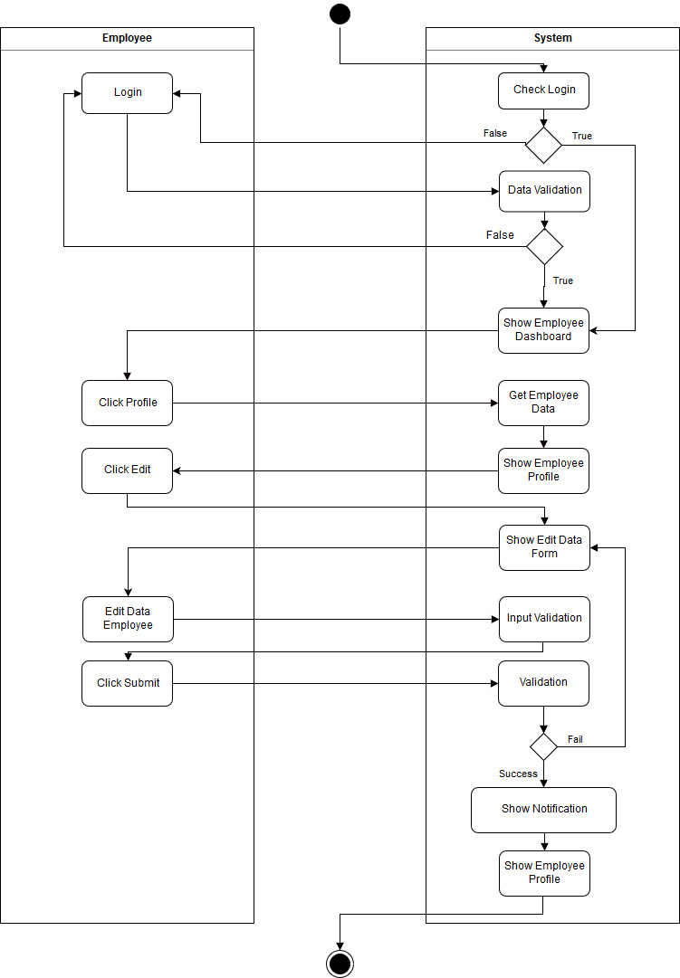
Manage
Profile

Slide 18
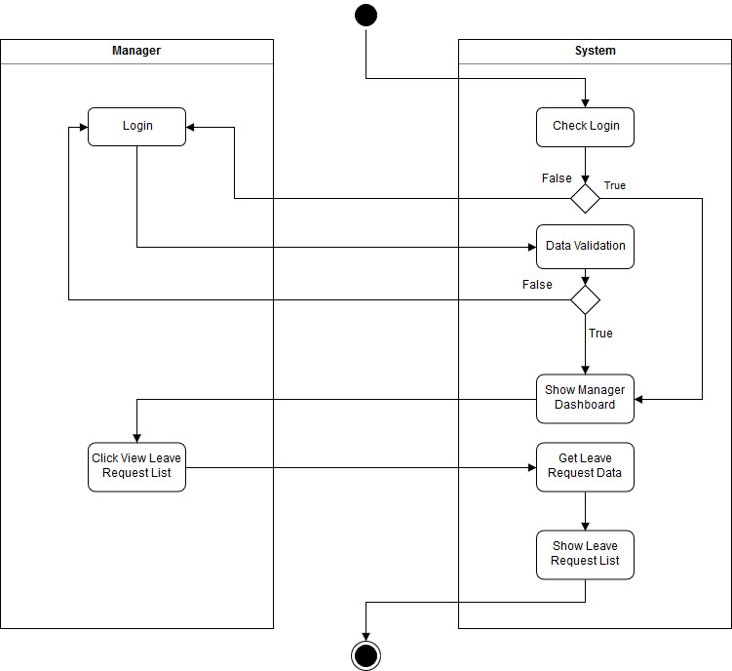
View Leave
Request List

Slide 19
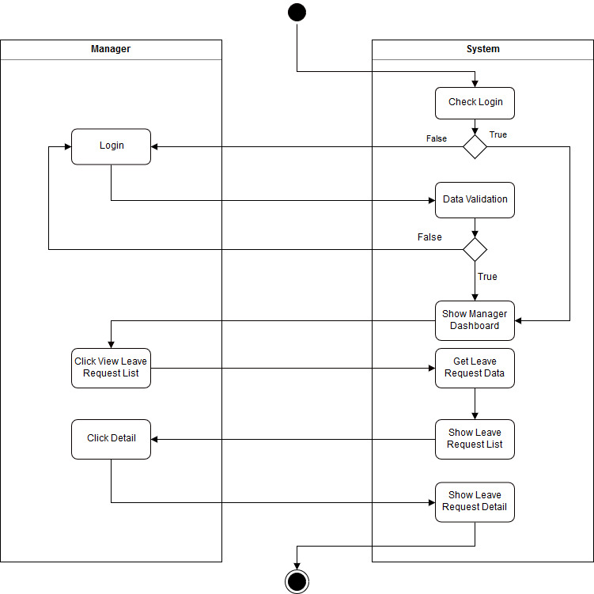
View Detail

Slide 20
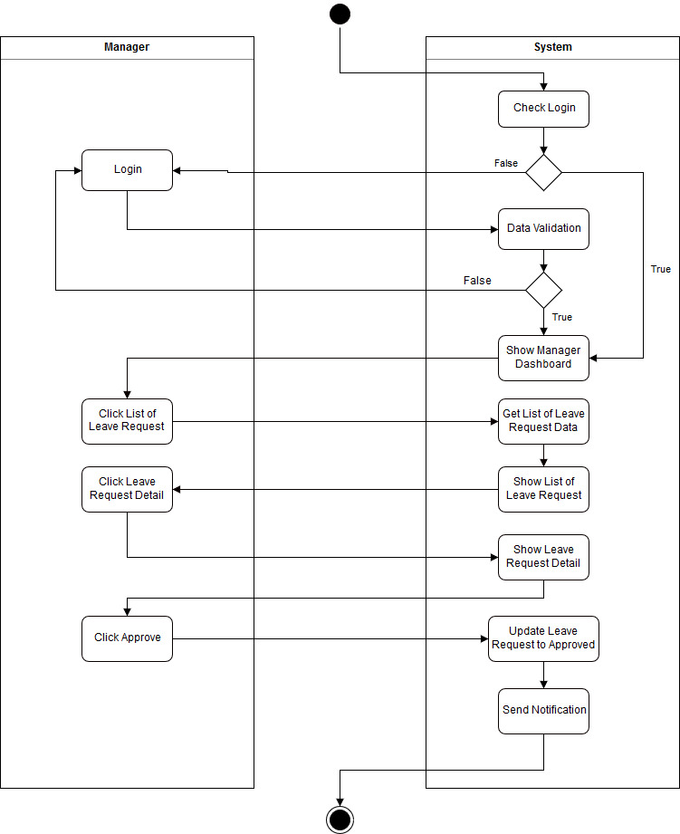
Manager
Approval

Slide 21
View Leave
History

Slide 22
Change
Password

Slide 23
Manage
Profile

Slide 24

Manage Data
User

Slide 25
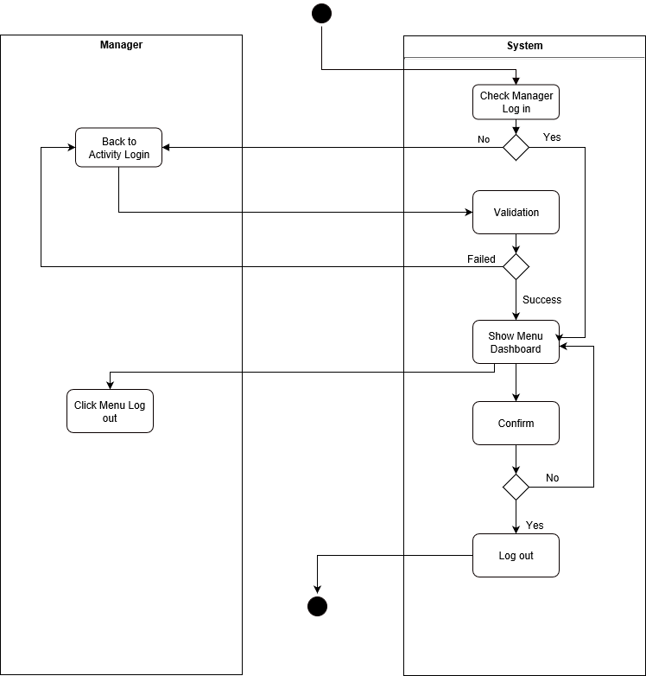
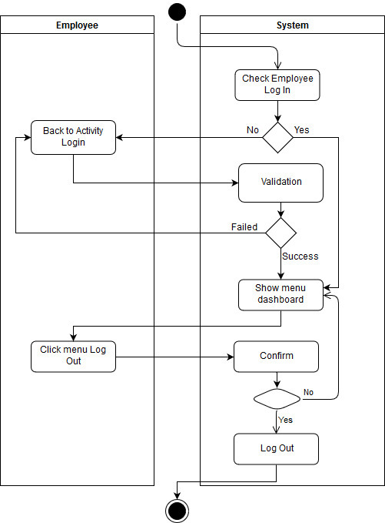
Logout Employee
Logout Manager

Slide 26
Insert Employee
CREATE SEQUENCE SQ_masteremployee
MINVALUE 1
START WITH 10000
INCREMENT BY 1
NOCACHE;
CREATE OR REPLACE PROCEDURE SP_login (in_id IN varchar2, in_email IN varchar2)
AS
BEGIN
insert into masterlogin values (in_id, in_email, 'passdefault', 'MRO_EMP');
END;
CREATE OR REPLACE PROCEDURE SP_leaveavailability (in_id IN varchar2)
AS
BEGIN
insert into leaveavailability values (in_id,0,0);
END;

Slide 27
CREATE OR REPLACE TRIGGER TR_masteremployee
AFTER INSERT ON masteremployee
FOR EACH ROW
BEGIN
SP_login(:new.id, :new.email);
SP_leaveavailability(:new.id);
END;

Slide 28
CREATE OR REPLACE PROCEDURE SP_masteremployee(
in_name IN varchar2,
in_email IN varchar2,
in_gender IN varchar2,
in_phone_number IN varchar2,
in_hire_date IN date,
in_street IN varchar2,
in_ismarried IN varchar,
in_job_id IN varchar2,
in_village_id IN varchar2,
in_religion_id IN varchar2,
in_manager_id IN varchar2,
in_department_id IN varchar2
)
AS
BEGIN
insert into masteremployee values (
SQ_masteremployee.nextval, in_name, in_email, in_gender, in_phone_number, in_hire_date, in_street, in_ismarried, in_job_id, in_village_id, in_religion_id, in_manager_id, in_department_id
);
END;

Slide 29
create or replace procedure SP_UpdateEmployee (
in_id IN varchar2,
in_name IN varchar2,
in_email IN varchar2,
in_gender IN varchar2,
in_phone_number IN varchar2,
in_hire_date IN date,
in_street IN varchar2,
in_ismarried IN varchar,
in_job_id IN varchar2,
in_village_id IN varchar2,
in_religion_id IN varchar2,
in_manager_id IN varchar2,
in_department_id IN varchar2)
IS
begin
update MasterEmployee set name=in_name, email=in_email, gender=in_gender, phone_number=in_phone_number, hire_date=in_hire_date, street=in_street, ismarried=in_ismarried,
job_id=in_job_id, village_id=in_village_id, religion_id=in_religion_id, manager_id=in_manager_id, department_id=in_department_id where id=in_id ;
end;

Slide 30
create or replace procedure SP_ViewEmployee
IS cursor e_data is select id, name, email,
gender, phone_number, hire_date,
street, isMarried, job_id, village_id,
religion_id, manager_id, department_id from MasterEmployee;
result e_data%rowtype;
begin
for result in e_data loop
dbms_output.put_line('---------------------');
dbms_output.put_line('Id : '||result.id);
dbms_output.put_line('Name : '||result.name);
dbms_output.put_line('Email : '||result.email);
dbms_output.put_line('Gender : '||result.gender);
dbms_output.put_line('Phone Number : '||result.phone_number);
dbms_output.put_line('Hire Date : '||result.hire_date);
dbms_output.put_line('Street : '||result.street);
dbms_output.put_line('isMarried : '||result.isMarried);
dbms_output.put_line('Job Id : '||result.job_id);
dbms_output.put_line('Village Id : '||result.village_id);
dbms_output.put_line('Religion : '||result.religion_id);
dbms_output.put_line('Manager Id : '||result.manager_id);
dbms_output.put_line('Department Id : '||result.department_id);
end loop;
end;

Slide 31
create or replace procedure SP_ViewEmployee
IS cursor e_data is select id, name, email,
gender, phone_number, hire_date,
street, isMarried, job_id, village_id,
religion_id, manager_id, department_id from MasterEmployee;
result e_data%rowtype;
begin
for result in e_data loop
dbms_output.put_line('---------------------');
dbms_output.put_line('Id : '||result.id);
dbms_output.put_line('Name : '||result.name);
dbms_output.put_line('Email : '||result.email);
dbms_output.put_line('Gender : '||result.gender);
dbms_output.put_line('Phone Number : '||result.phone_number);
dbms_output.put_line('Hire Date : '||result.hire_date);
dbms_output.put_line('Street : '||result.street);
dbms_output.put_line('isMarried : '||result.isMarried);
dbms_output.put_line('Job Id : '||result.job_id);
dbms_output.put_line('Village Id : '||result.village_id);
dbms_output.put_line('Religion : '||result.religion_id);
dbms_output.put_line('Manager Id : '||result.manager_id);
dbms_output.put_line('Department Id : '||result.department_id);
end loop;
end;

Slide 32
Leave Request
CREATE SEQUENCE SQ_masterleave
MINVALUE 1
START WITH 5
INCREMENT BY 1
NOCACHE;
CREATE OR REPLACE PROCEDURE SP_getleaveavailability (inid IN varchar2, outcurr OUT number, outlast OUT number)
AS
begin
select current_year, last_year into outcurr, outlast
from leaveavailability
where id = inid;
end;

Slide 33
CREATE OR REPLACE PROCEDURE SP_leaverequest(
note IN varchar2,
leave_duration IN number,
start_from IN varchar2,
submit_date IN varchar2,
employee_id IN varchar2,
leave_category_id IN varchar2,
current_year_before OUT number,
last_year_before OUT number
)
AS
finish_to date;
check_duration varchar2(7);
BEGIN
SP_getleaveavailability(employee_id, current_year_before, last_year_before);
check_duration := FN_checkduration(leave_duration, current_year_before, last_year_before);
finish_to := FN_checkholiday(start_from, leave_duration);
if (check_duration = 'valid') then
insert into masterleave values (
SQ_masterleave.nextval, note, leave_duration, TO_DATE(start_from, 'yyyy/mm/dd'), finish_to,
current_year_before ,last_year_before , TO_DATE(submit_date, 'yyyy/mm/dd'), 'Pending',
null, employee_id, leave_category_id );
else dbms_output.put_line('Leave duration invalid');
end if;
END;

Slide 34
CREATE OR REPLACE TRIGGER TR_masterleaveinsertfile
AFTER INSERT ON masterleave
FOR EACH ROW
BEGIN
SP_insertfile(null, 'file for '||:new.id, :new.id);
END;
CREATE OR REPLACE PROCEDURE SP_insertfile(
id IN varchar2,
name IN varchar2,
leave_id IN varchar2
)
AS
BEGIN
insert into masterfile values (id, name, leave_id );
END

Slide 35
CREATE OR REPLACE FUNCTION FN_checkholiday(indate IN varchar2, induration IN number)
RETURN VARCHAR2 IS result VARCHAR2(20);
finish_to date;
n number;
day number;
thereis number;
BEGIN
finish_to := TO_DATE(indate, 'yyyy/mm/dd') - 1;
for n in 1..induration loop
finish_to := finish_to + 1;
select count(holiday_date) into thereis from masterholiday where holiday_date=finish_to;
if (thereis >= 1) then
finish_to := finish_to + 1;
end if;
day := to_char (finish_to, 'D');
if (day = 1) then finish_to := finish_to + 1;
else if (day = 7) then finish_to := finish_to + 2;
end if;
end if;
end loop;
result := 'finish to '|| finish_to ;
RETURN result;
END;

Slide 36
CREATE OR REPLACE FUNCTION FN_checkduration (induration IN number, incurrent IN number, inlast IN number)
RETURN varchar2 IS result varchar2(7);
maxduration number;
minduration number;
leaveavailable number;
BEGIN
leaveavailable := incurrent + inlast;
select value into maxduration from parameter where id=1;
select value into minduration from parameter where id=2;
if ((induration > maxduration) or (induration < minduration) or (induration > leaveavailable)) then result := 'invalid';
else result := 'valid';
end if;
RETURN result;
END;

Slide 37
Manager Approve
CREATE OR REPLACE PROCEDURE SP_approve_la (inid IN varchar2, instatus IN varchar2)
as
arr varchar2(20);
emp_id varchar2(9);
current_year_count number;
last_year_count number;
BEGIN
update masterleave set request_status=instatus, approval_date=sysdate where id=inid;
if (instatus= 'Approved') then
arr := FN_getnewleavecount(inid);
emp_id := FN_splitbycomma(arr,1);
current_year_count := FN_splitbycomma(arr,2);
last_year_count := FN_splitbycomma(arr,3);
SP_updateleaveavailability(emp_id, current_year_count, last_year_count);
end if;
END;

Slide 38
CREATE OR REPLACE PROCEDURE SP_updateleaveavailability(inid IN varchar2, incurr IN number, inlast IN number)
AS
begin
update leaveavailability set current_year=incurr,last_year=inlast where id=inid ;
end;
CREATE OR REPLACE FUNCTION FN_splitbycomma(instring IN VARCHAR2, inpos IN VARCHAR2)
RETURN VARCHAR2 IS
BEGIN
RETURN REGEXP_SUBSTR(instring, '(.*?)(\,|$)',1, inpos, null, 1);
END;

Slide 39
CREATE OR REPLACE FUNCTION FN_getnewleavecount(inid IN varchar2)
RETURN VARCHAR2 IS result VARCHAR2(20);
current number;
last number;
duration number;
emp_id varchar2(9);
new_count number;
BEGIN
select current_year, last_year, leave_duration, employee_id into current, last, duration, emp_id
from masterleave mle join leaveavailability la
on mle.employee_id=la.id
where mle.id = inid;
if(last < duration ) then
new_count := current + last;
new_count := new_count - duration;
result := new_count||','||0;
else if(last >= duration ) then
new_count := last - duration;
result := current||','||new_count;
end if;
end if;
RETURN result;
END;

Slide 40
Manager Approve
CREATE OR REPLACE PROCEDURE SP_getleaveavailability (inid IN varchar2, outcurr OUT number, outlast OUT number)
AS
begin
select current_year, last_year into outcurr, outlast
from leaveavailability
where id = inid;
end;
CREATE OR REPLACE PROCEDURE SP_updateleaveavailability(inid IN varchar2, incurr IN number, inlast IN number)
AS
begin
update leaveavailability set current_year=incurr,last_year=inlast where id=inid ;
end;

Slide 41
Scheduler
CREATE OR REPLACE PROCEDURE SP_getleaveavailability (inid IN varchar2, outcurr OUT number, outlast OUT number)
AS
begin
select current_year, last_year into outcurr, outlast
from leaveavailability
where id = inid;
end;
CREATE OR REPLACE PROCEDURE SP_updateleaveavailability(inid IN varchar2, incurr IN number, inlast IN number)
AS
begin
update leaveavailability set current_year=incurr,last_year=inlast where id=inid ;
end;

Slide 42
Switch on Monthly
create or replace procedure SP_Increment_Monthly
is cursor mydata is select id from leaveavailability;
result mydata%rowtype;
curr number;
last number;
begin
for result in mydata loop
SP_getleaveavailability(result.id, curr, last);
curr := curr + 1;
SP_updateleaveavailability(result.id, curr, last);
END LOOP;
end;
begin
dbms_scheduler.create_job(job_name => 'Increment_Monthly',
job_type => 'STORED_PROCEDURE',
job_action => 'SP_Increment_Monthly',
start_date => systimestamp,
end_date => null,
repeat_interval => 'FREQ=YEARLY; BYMONTH=2,3,4,5,6,8,9,10,11,12;',
enabled => true,
auto_drop => false,
comments => 'Run a procedure to increase leave count by 1');
end;

Slide 43
Switch on 1st July
create or replace procedure SP_switchonfirstjuly
is
cursor mydata is select id from leaveavailability;
result mydata%rowtype;
curr number;
last number;
begin
for result in mydata loop
SP_getleaveavailability(result.id, curr, last);
curr := curr + 1;
SP_updateleaveavailability(result.id, curr, 0);
END LOOP;
end;
begin
dbms_scheduler.create_job(job_name => 'Switch_Leave_On_July',
job_type => 'STORED_PROCEDURE',
job_action => 'SP_switchonfirstjuly',
start_date => systimestamp,
end_date => null,
repeat_interval => 'FREQ=YEARLY; BYDATE=0701;',
enabled => true,
auto_drop => false,
comments => 'Run a procedure to set last year leave count to zero');
end;

Slide 44
Switch on 1st January
create or replace procedure SP_switchonfirstjanuary
is
cursor mydata is select id from leaveavailability;
result mydata%rowtype;
curr number;
last number;
begin
for result in mydata loop
SP_getleaveavailability(result.id, curr, last);
SP_updateleaveavailability(result.id, 1, curr);
END LOOP;
end;
begin
dbms_scheduler.create_job(job_name => 'Switch_Leave_On_January',
job_type => 'STORED_PROCEDURE',
job_action => 'SP_switchonfirstjanuary',
start_date => systimestamp,
end_date => null,
repeat_interval => 'FREQ=YEARLY; BYDATE=0101;',
enabled => true,
auto_drop => false,
comments => 'Run a procedure to switch leave number from current year to last year and set current year to 1');
end;

Slide 45
Thank you ! ☺
Any Questions?

